Slide 1

Project Exhibition - 2
Final Review
Online Job Portal (Web Application)
- Group 59

Slide 2

Online Job Portal
GUIDE :- Dr Alangudi Balaji
Team Members :-
Saurabh Shinde 19BCE10028
Nirmal Rushikesh 19BCE10003
Saurabh Jaybhaye 19BCE10145
Harsh Khandelwal 19BCE10325

Slide 3

Introduction
The importance of placement system is increasing day by day.
Thousands of applicants are depending on placement cell.
But the applicants are facing so many problems.
This project is an attempt to minimize the problems of applicants to find a matching job.
If we can make it online and computerized and a mobile alert process, it will be so fast and convenient for the applicants to stay updated with vacancies available .

Slide 4
Existing Work with Limitations
•All data processing is done manually.
•Files and record books are replaced with software system.
•By implementing a computerized system , the limitations in the present system will be reduced.
• Reduction in man power.
•Reduction in time consumption.
•Fast and easy process.

Slide 5
Proposed Work and Methodology
•The proposed system aims at eliminating the limitations of the existing system via increasing speed of information retrieval .
•There would be increment in processing speed, data security and hence give accurate reports.
•The proposed system fully satisfies user needs.
•Details are stored in various files from which data can be accessed and manipulated easily.

Slide 6
Novelty
Taking motivation from the conventional systems and their drawbacks and inspiration from the existing job search portals, we have decided to develop “Dreams Job”.
In the proposed system we are trying to develop an online job search web application that reduces challenges for job seekers to find a desired and suitable job according to their qualification.
We aim at reducing the challenges by providing advanced search features that gives the candidate ample scope to select jobs that matches their skill set and requirements and gives them back the exact jobs that are available.

Slide 7
Video Resume
Ok so WHAT'S NEW ?
Video resume lowers the chance for faking !
As a recruiter, you want to get quickly to the best-qualified candidates and avoid fake applicants. In a video resume, you will be able to better assess the technical skills of the applicant and other skills necessary for the job.

Slide 8
Problem Statement
Whether entering the job market for the first time or re-entering after a break or switching career, job search is a challenging task.
But how about tools/applications, making this tedious process look friendly, systematic and easy to reach out, to employers or candidates.
Searching and landing up with a dream job is a tedious process for a job seeker and on the opposite hand, connecting with desirable candidates best fit for a job position is a challenging and important work for the employers.
This project is aimed at making such challenges much easier despite the geographic location of either the job seeker or the Company

Slide 9

Real Time Usage
•Job portal is a website and is known as a bridge between an organization and job seekers.
•Creating job portals helps both – organizations and job seekers to connect and grow together.
•In simple words, suppose you have a vacancy in your organization, and for that, you craft an attractive job ad.
•Now a days we also have Internship portals for students and professionals just like job portals which is very similar.
•In the same way freelancing website are also available where employers can hire free lancers for short period of time or for specific project.

Slide 10

Hardware and Software Requirements for Developer
Processors : Intel i5 6th gen
Hard Disk : Minimum 512 GB Hard Disk
RAM : Minimum 8 GB
Display Type : SVGA Color Monitor
Keyboard : Enhanced 104 Standard
Mouse : USB or PS/2 2 Button
WINDOWS 7
WINDOWS 10 (Rec.)

Slide 11
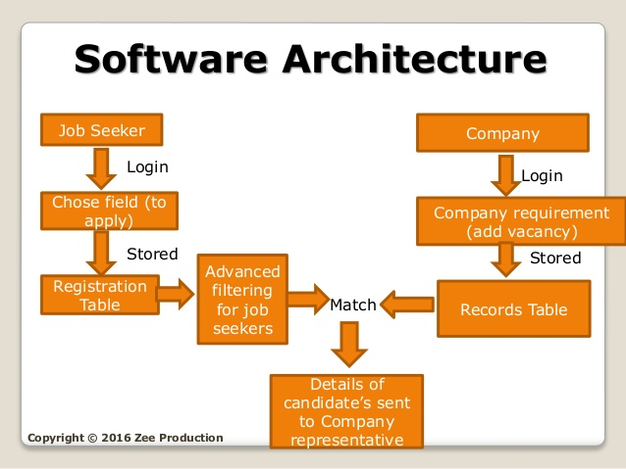
Overall System Architecture

Slide 12
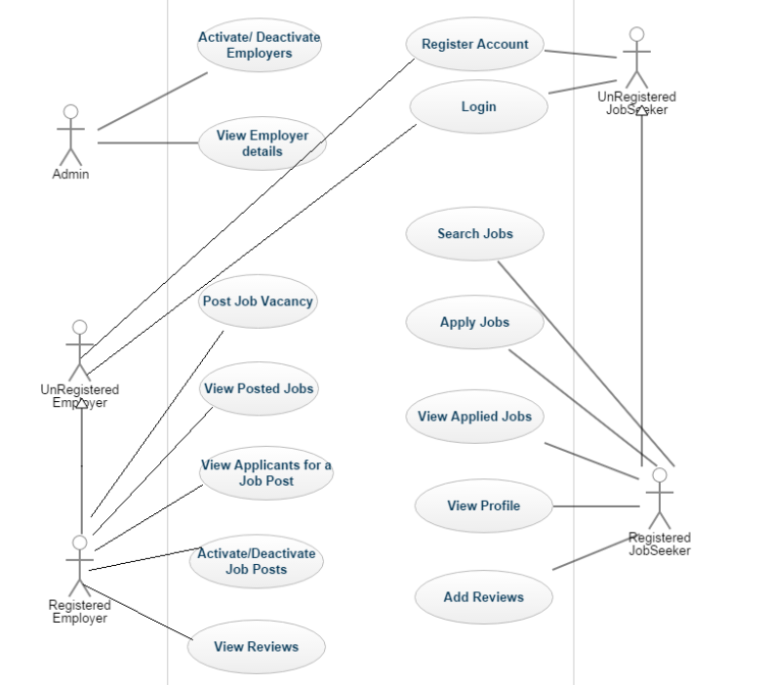
Module split-up

Slide 13

Module work flow explanation

Slide 14
Admin control
Login Registration Homepage Logout Employers details Updates
Job seeker control
Registration Login Search Profile Dashboard Upload Resume Newsletter
Service
Newsletter Premium service International jobs Save jobs Apply jobs Login Dashboard Poll Contact
Employer control
Registration Login Post jobs Job details Update Candidates Resumes

Slide 15

Snap Shots Of The Project

Slide 16
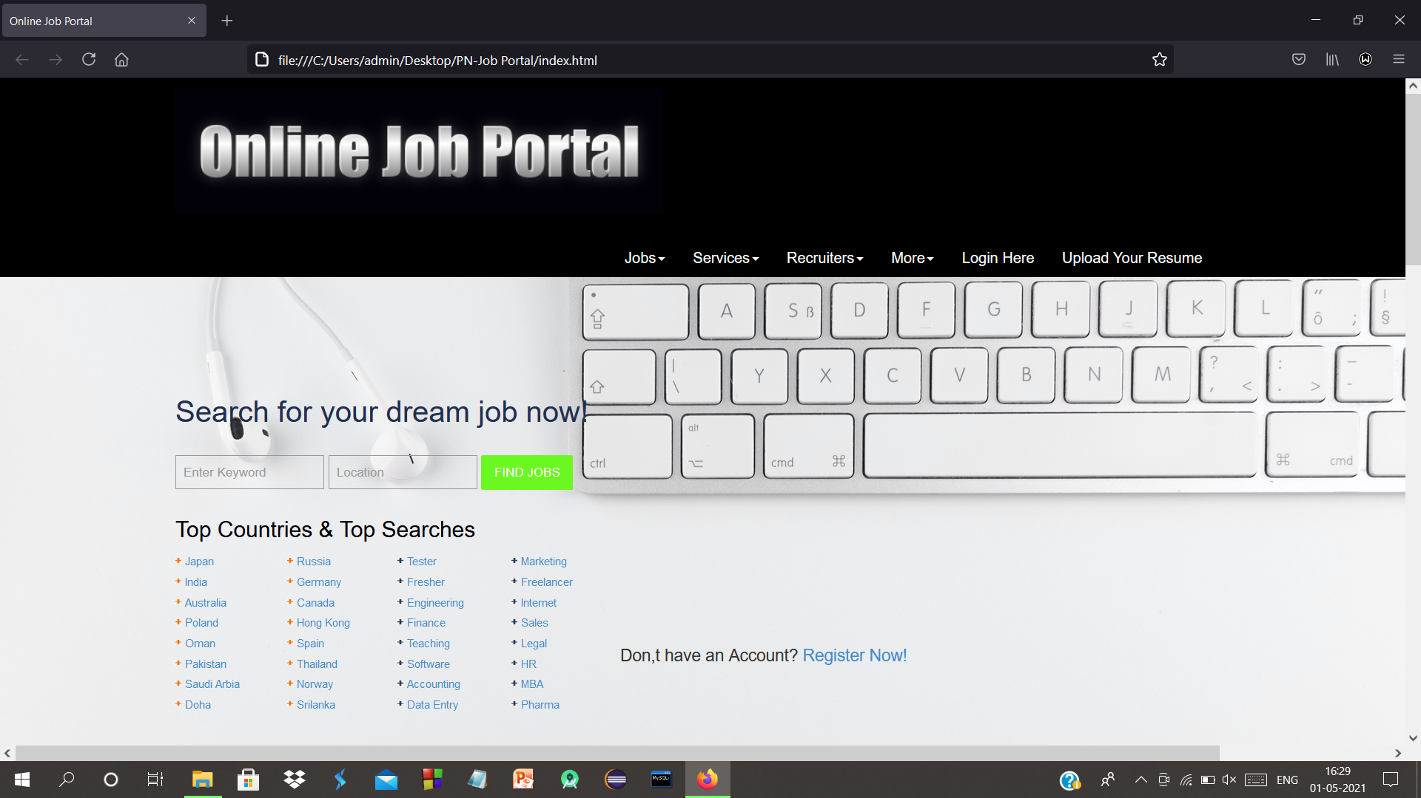

Slide 17
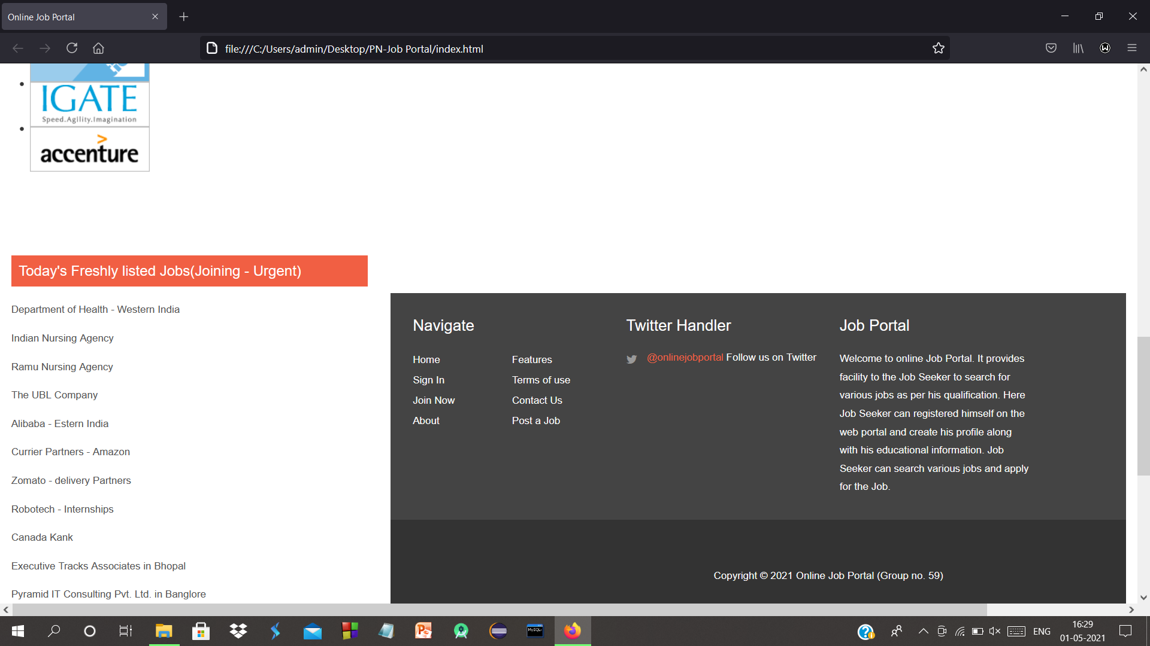

Slide 18
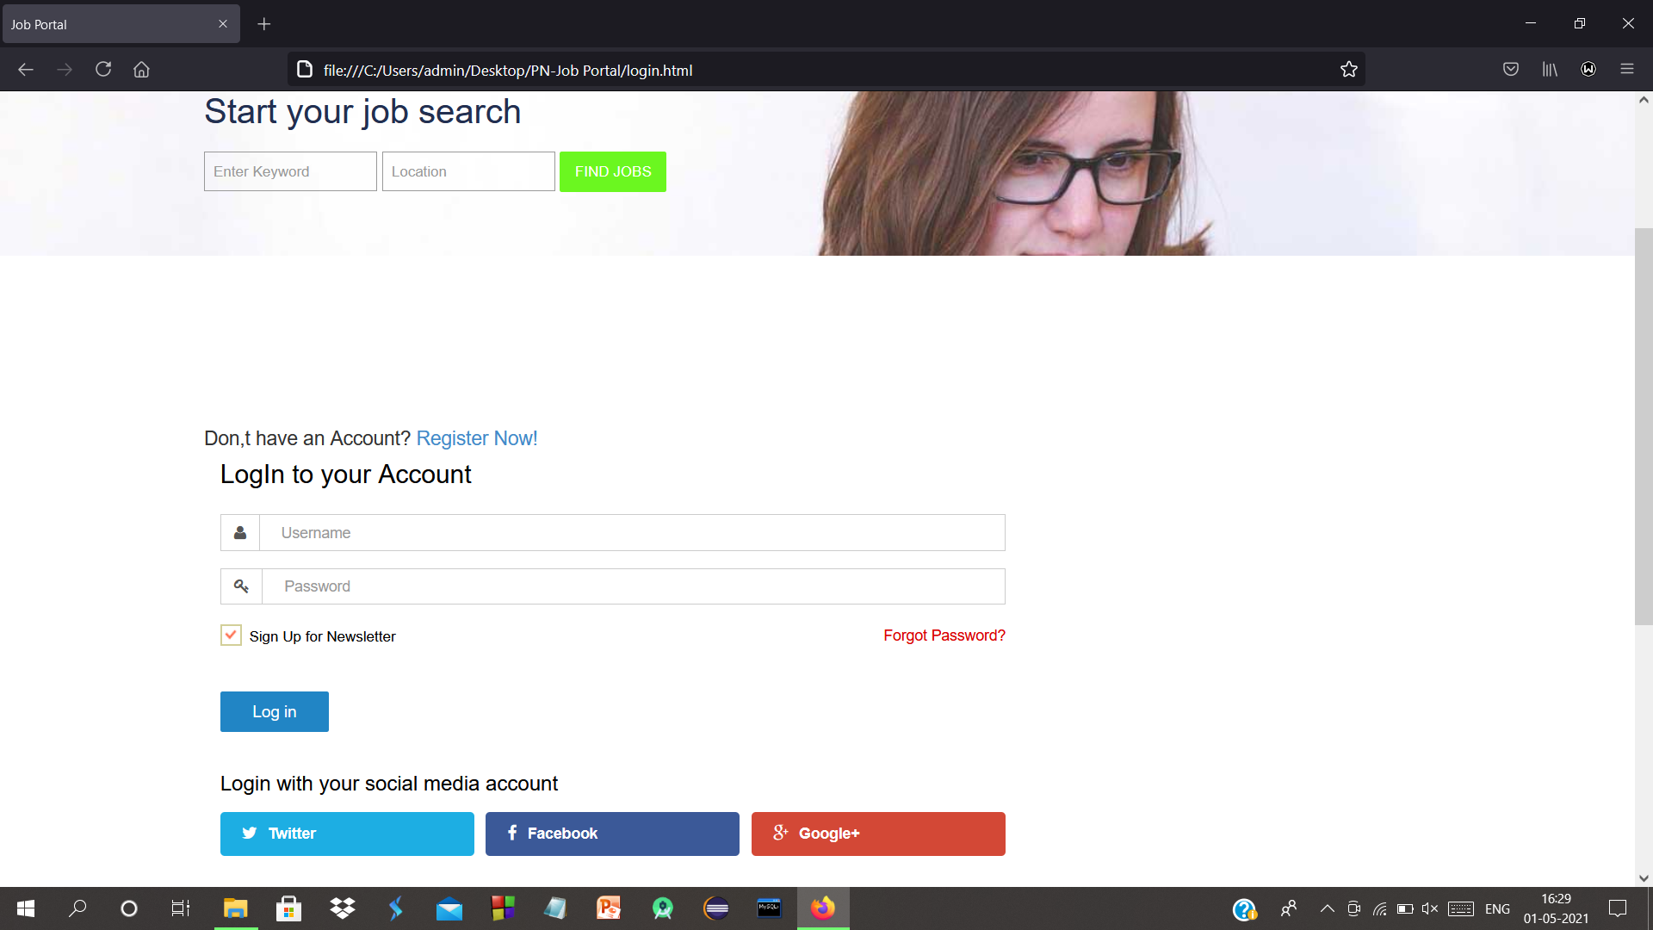

Slide 19
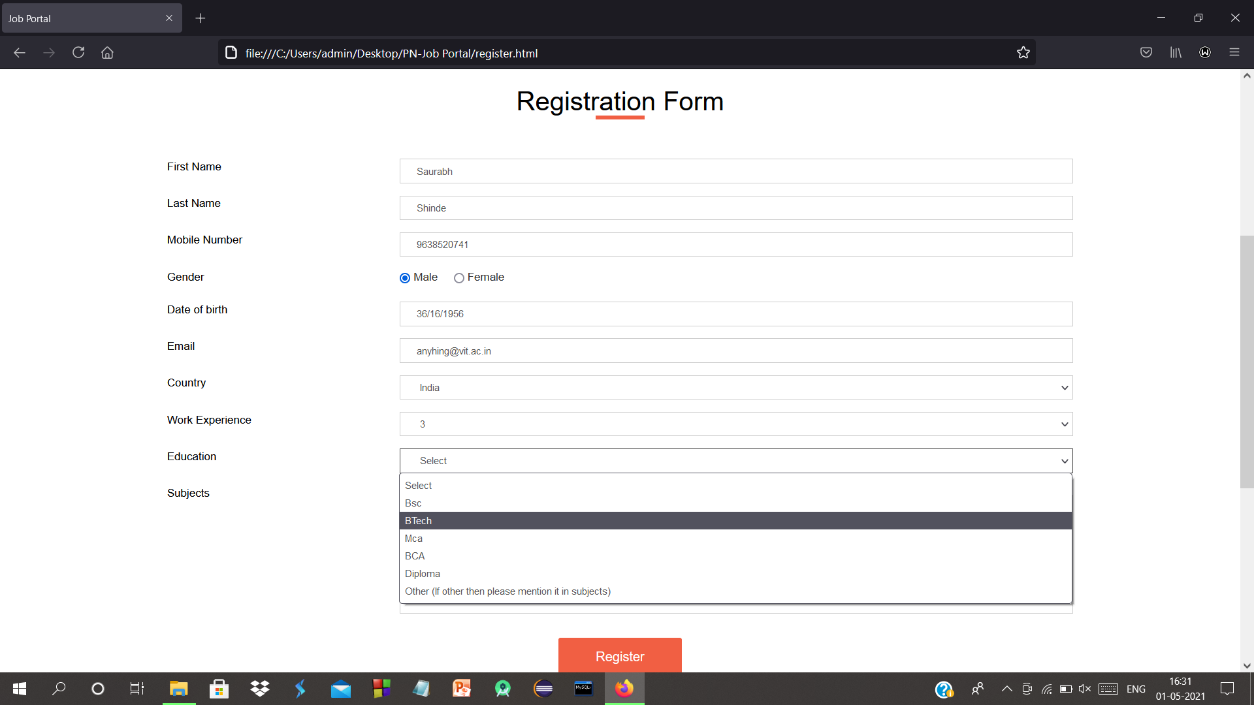

Slide 20
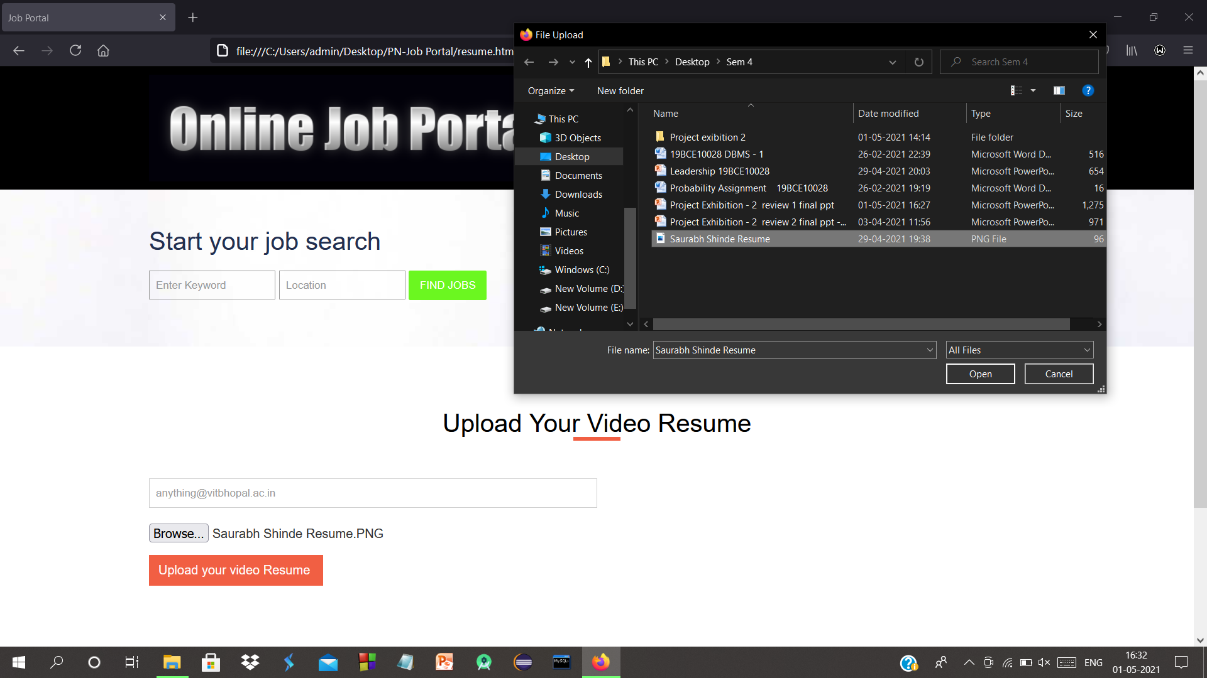

Slide 21
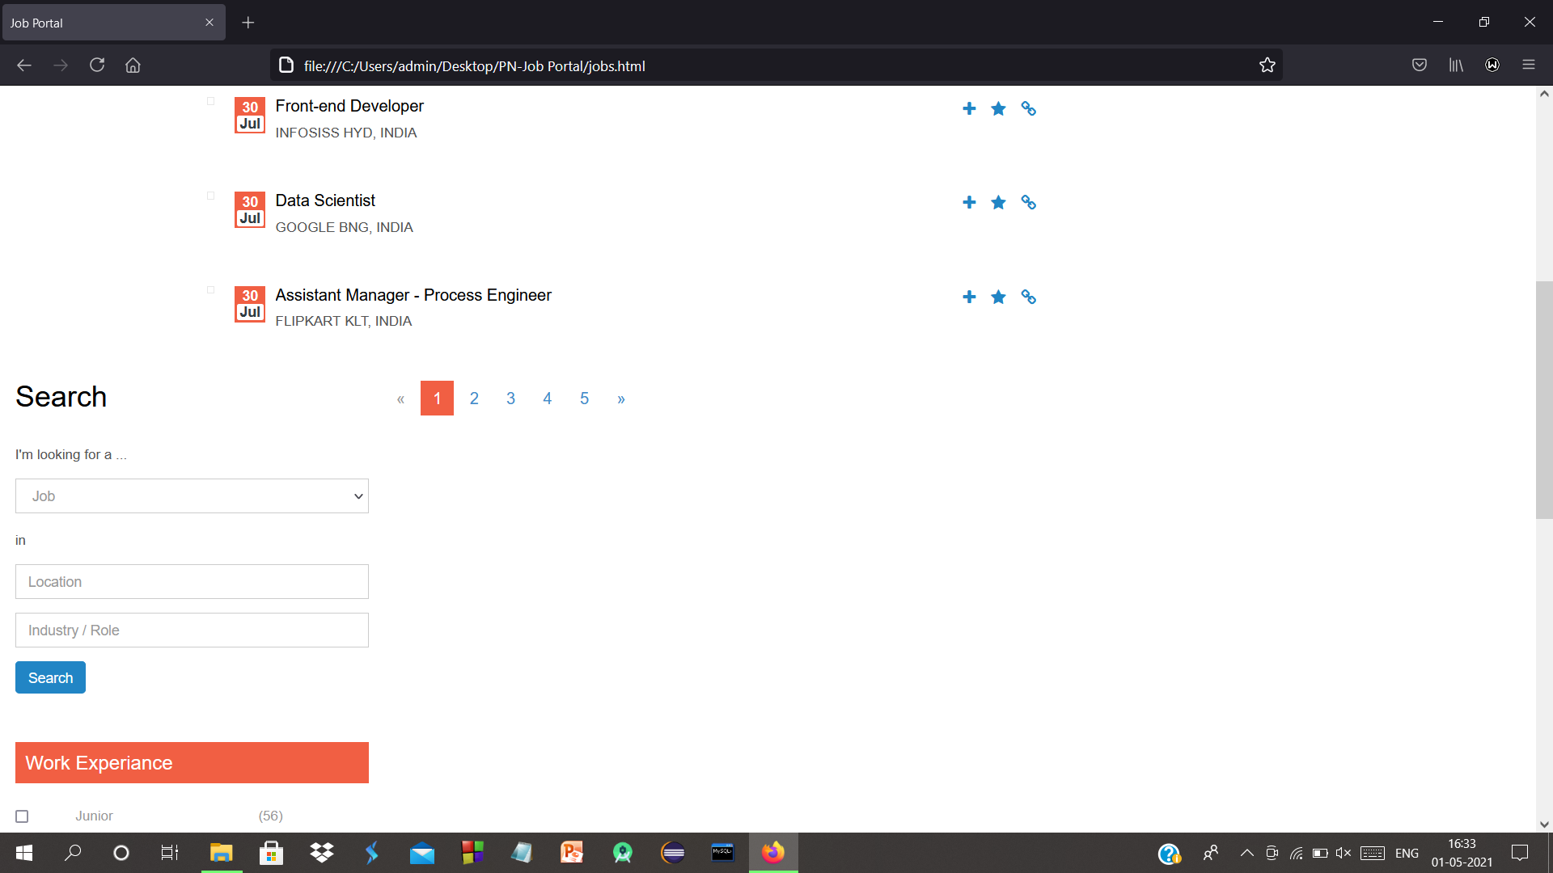

Slide 22
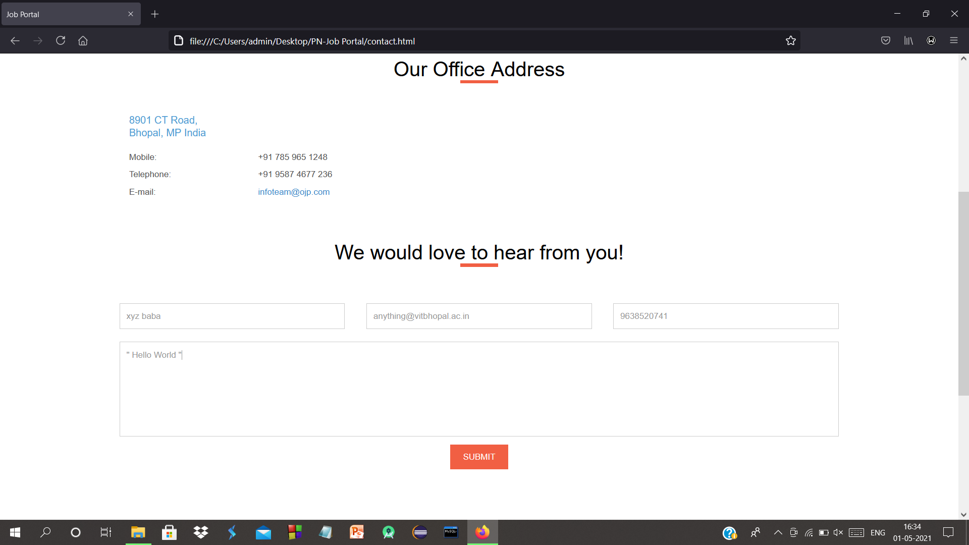

Slide 23

DEMO VEDIO

Slide 24
Conclusion
Job Search Portals stands as a revolutionizing element in the sphere of recruitment.
They act as a communication bridge between applicants and recruiters facilitating their requirements.
This application helps organizations to have a greater exposure to the candidate pool and also job seekers facilitating wide search of jobs matching their interests.
The android application provides flexibility to the jobseekers to view the openings and applied jobs without the need to carry a laptop.
This application provides an enhanced user experience for both employer and jobseeker.
It provides user friendly interface which facilitates in reaching wide range of audience.

Slide 25

Hope you find your dream Job – From Group no.59

